Slide 1
BASIC STATISTICS
MODULE 2
BHAVYA H
STATISTICS PROFESSIONAL
SPOCTEC TECHNOLOGICAL AND RESEARCH CENTRE

Slide 2
Measures of Central Tendency
A single number to serve as a representative value around which all the numbers in the set tend to cluster.
There are three common measures of central tendency:
the mean
the median
the mode

Slide 3
Mean
The mean (arithmetic mean) of a set of data is found by summing the values and dividing by the number of values.
Properties of the Arithmetic Mean
All the values are included in computing the mean.
A set of data has a unique mean.
The mean is affected by unusually large or small data values.
The arithmetic mean is the only measure of location where the sum of the deviations of each value from the mean is zero.

Slide 4
Formula for the Mean
Example:
Ten students were polled as to the number of siblings in their individual families.
The raw data is the following set: {3, 2, 2, 1, 3, 6, 3, 3, 4, 2}.
Find the mean number of siblings for the ten students.

Slide 5
Example Continued

Slide 6
Median
This measure divides a group of numbers into two parts, with half the numbers below the median and half above it.
The median is not as sensitive to extreme values as the mean.
Calculation of the median from raw data
Let n = the number of observations
If n is odd, the median is the th observation
If n is even, the median is the mean of the th observation and the th observation

Slide 7
Calculation of the median from a grouped frequency distribution
The class interval that contains the median is called the median class
Where
Md = the median
L = the lower limit of the median class
N = Σf = the total number of observations in the set
C = the cumulative frequency of the class preceding the median class
f = the frequency of the median class
i = the length of the class interval of the median class

Slide 8
Properties of Median
There is a unique median for each data set.
It is not affected by extremely large or small values and is therefore a valuable measure of location when such values occur.

Slide 9
Example:
Nine students in a math class were polled as to the number of siblings in their individual families and the results were:
3, 2, 2, 1, 6, 3, 3, 4, 2.
Find the median number of siblings for the ten students.
Position of the median:
The 5th value
In order: 1, 2, 2, 2, 3, 3, 3, 4, 6
Median = 3 siblings

Slide 10
Mode
The mode is the number that occurs most frequently in a data set.
Normally, the mode is used for categorical data where we wish to know which is the most common category.
It is insensitive to large changes in the data set.

Slide 11
Calculation of the mode from a grouped frequency distribution
The class interval with the largest frequency is called the modal class
Where
L = the lower limit of the modal class
d₁ = the frequency of the modal class minus the frequency of the previous class
d₂ = the frequency of the modal class minus the frequency of the next class above the modal class
i = the length of the class interval of the modal class

Slide 12
EXAMPLE
Find the median and mode for the following distribution:
Class interval: 0-10 10-20 20-30 30-40 40-50 50-60 60-70 70-80
Frequency: 5 8 7 12 28 20 10 10
Modal Class
(highest frequency)
Cumulative frequency greater than
is 60.
Median Class

Slide 13
Example Continued
Median is :
Mode is:

Slide 14
Bimodal Distributions
When a distribution has two “modes,” it is called bimodal

Slide 15
Multimodal Distributions
If a distribution has more than 2 “modes,” it is called multimodal

Slide 16
Example:
Ten students in a math class were polled as to the number of siblings in their individual families and the results were: 3, 2, 2, 1, 3, 6, 3, 3, 4, 2. Find the mode for the number of siblings.
3, 2, 2, 1, 3, 6, 3, 3, 4, 2
The mode for the number of siblings is 3.

Slide 17
WEIGHTED AVERAGE
Let be the weights attached to variable values respectively. Then the weighted arithmetic mean is given by:

Slide 18
Example
During a one hour period on a hot Saturday afternoon Raju served fifty drinks. He sold five drinks for Rs.50, fifteen for Rs.75, fifteen for Rs.90, and fifteen for Rs.110. Compute the weighted mean of the price of the drinks.

Slide 19
VARIANCE
The variance is the usual measure of dispersion in statistical theory.
Variance is the average of the squared deviations from the mean.
If is a set of N observations then its variance is given by:
Drawback: variance is expressed in the squared units, which may not make intuitive or practical sense
Standard Deviation = Square root of Variance

Slide 20
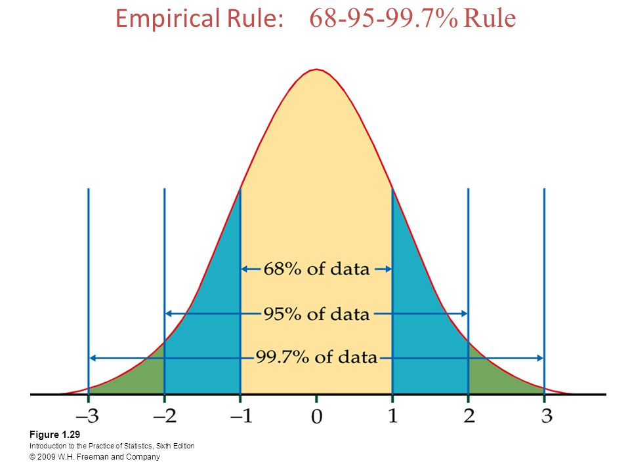

Slide 21
Example
The math test scores of five students are: 92,88,80,68 and 52.
Find the variance and standard deviation
Find the mean: (92+88+80+68+52)/5 = 76.
Find the deviation from the mean:
92-76=16
88-76=12
80-76=4
68-76= -8
52-76= -24

Slide 22
Example Continued
Square the deviation from the mean:
The sum of the squares of the deviation from the mean:
256+144+16+64+576= 1056
Divide by the number of data items to find the variance:
1056/5 = 211.2
Find the square root of the variance. Thus the standard deviation of the test scores is 14.53.

Slide 23
COVARIANCE
Covariance measures how much the movement in one variable predicts the movement in a corresponding variable.
Formula for covariance between two numerical variables X and Y :
Drawback: Affected by the units in which X and Y are measured

Slide 24
Scatterplots and correlation
A scatterplot is a scatter of points, where each point denotes the values of an observation for two selected variables.
Correlation describes linear relationships between quantitative variables.
Formula for correlation

Slide 25
Scatter plots provide a convenient way to determine whether a correlation exists between two variables.
A positive correlation occurs when both variables increase.
A negative correlation occurs when one variable increases and the other variable decreases.
If the data points are randomly scattered there is little or no correlation.

Slide 26
Y
Y
Y
X
X
X
Positive correlation
Negative correlation
Little or no correlation

Slide 27
Interpretation of Correlation
Direction: positive, negative, ≈0
Strength: the closer |r| is to 1, the stronger the correlation
0.0 ≤ |r| < 0.3 ⇒ weak correlation
0.3 ≤ |r| < 0.7 ⇒ moderate correlation
0.7 ≤ |r| < 1.0 ⇒ strong correlation
|r| = 1.0 ⇒ perfect correlation

Slide 28
EXAMPLE
Investigate relationship between cigarette smoking and lung capacity.
Data: sample group response data on smoking habits, and measured lung capacities, respectively.
N | Cigarettes (X ) | Lung Capacity (Y )
1 | 0 | 45
2 | 5 | 42
3 | 10 | 33
4 | 15 | 31
5 | 20 | 29

Slide 29
SCATTERPLOT

Slide 30
Calculating Covariance
Cigs (X ) |  |  |  | Cap (Y )
0 | -10 | -90 | 9 | 45
5 | -5 | -30 | 6 | 42
10 | 0 | 0 | -3 | 33
15 | 5 | -25 | -5 | 31
20 | 10 | -70 | -7 | 29
 |  | ∑= -215

Slide 31
Covariance Calculation

Slide 32
Table for Calculating CORRELATION
 | Cigs (X ) | X ² | XY | Y ² | Cap (Y )
 | 0 | 0 | 0 | 2025 | 45
 | 5 | 25 | 210 | 1764 | 42
 | 10 | 100 | 330 | 1089 | 33
 | 15 | 225 | 465 | 961 | 31
 | 20 | 400 | 580 | 841 | 29
Total | 50 | 750 | 1585 | 6680 | 180

Slide 33

Computing
$$r_{xy}$$
Greater smoking exposure implies greater likelihood of lung damage.

Slide 34
Order Statistics
Suppose X₁ ,X₂ ,..., X_{n} iid (independent and identically distributed) random variables with a common distribution function F(x).
Let Y₁ ,Y₂ ,...,Y_{n} be random variables obtained by permuting the set X₁ ,X₂ ,..., X_{n} so as to be in increasing order.
To be specific:
Y₁ = min{X₁ ,X₂ ,..., X_{n}} and
Y_{n} = max{X₁ ,X₂ ,..., X_{n}}

